Slide 1


UK Energy Transition with Critical Mineral Constraint
Mohammad Hemmati, PhD
Research Fellow
Department of Chemical Engineering
Centre for Process Systems Engineering (CPSE)
University College London
Dec 2025

Slide 2
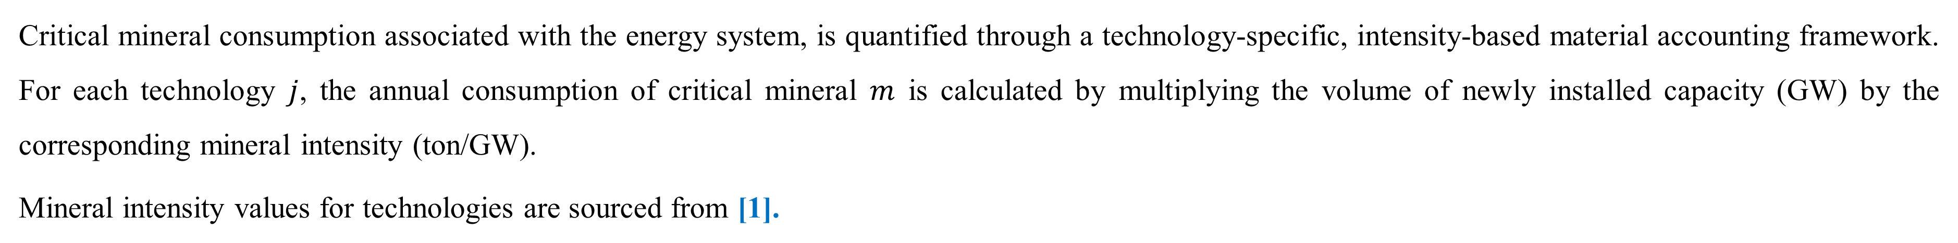
Methodology
Critical mineral consumption associated with the energy system, is quantified through a technology-specific, intensity-based material accounting framework. For each technology $j$, the annual consumption of critical mineral $m$ is calculated by multiplying the volume of newly installed capacity (GW) by the corresponding mineral intensity (ton/GW).
Mineral intensity values for technologies are sourced from [1].
Estimation of total available critical minerals
Total domestically available critical minerals in the UK are modelled as the sum of three components: (i) imports, (ii) secondary supply from recovery and recycling of end-of-life technologies, and (iii) domestic production from existing resource stocks. Supply data for all three categories are taken from and correspond to UK-level availability at the end of 2023 [2].
It is important to note that this represents the aggregate mineral availability for the entire UK economy. Only a portion of this national stock is assumed to be accessible to the energy sector, given ongoing mineral demand from other industries (e.g., transportation, electronics, defence). The proportion coefficient is taken from [1]. The analysis assumes that current domestic resource availability cannot be expanded during the modelling horizon.
The contribution of recovered minerals is estimated by applying a recovery factor to the stock of technologies expected to reach end of life or be decommissioned during the planning period:
[1]. Wei, Y. M., Liu, L. C., Kang, J. N., Zhang, Y., Peng, S., Liao, H., ... & Yu, B. (2025). Navigating energy transition solutions for climate targets with minerals constraint. Nature Climate Change, 15(8), 833-841. https://www.nature.com/articles/s41558-025-02373-3
[2]. UK Minerals Yearbook 2024

Slide 3
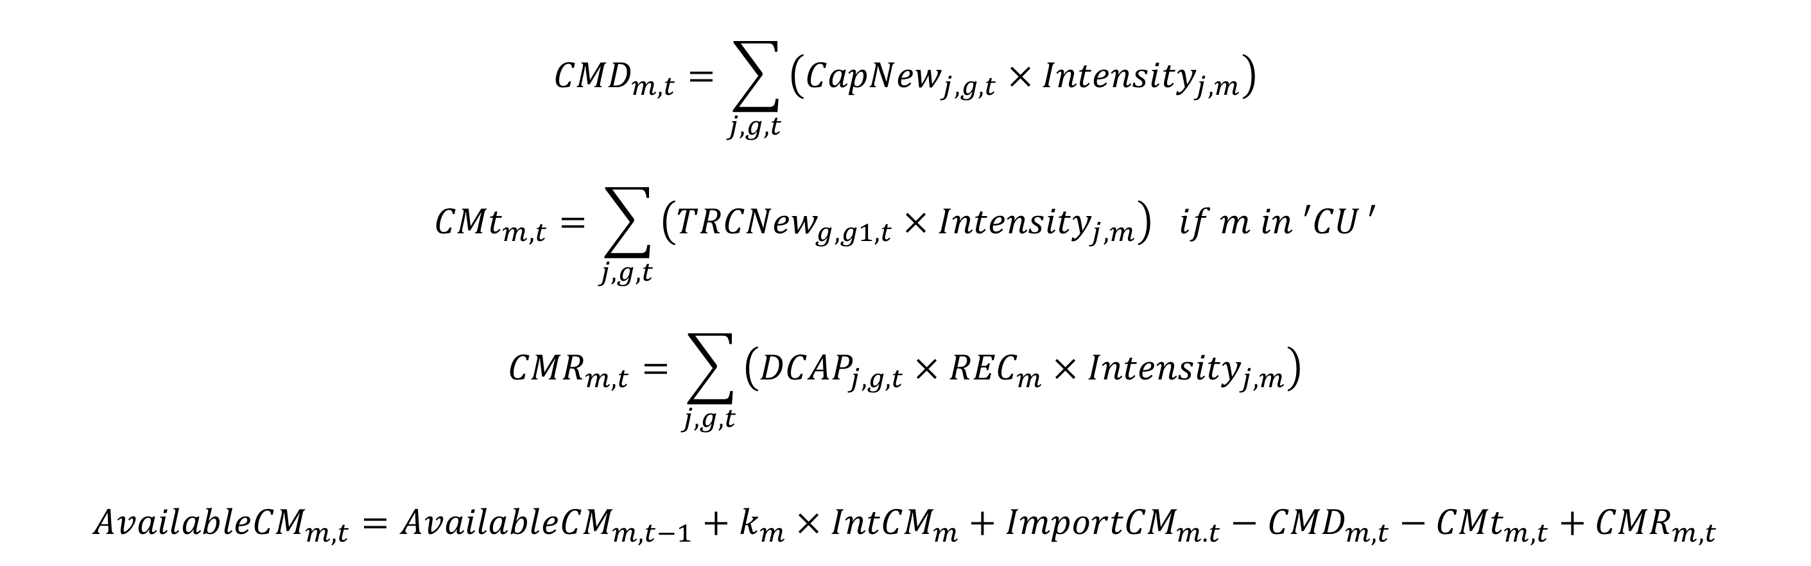
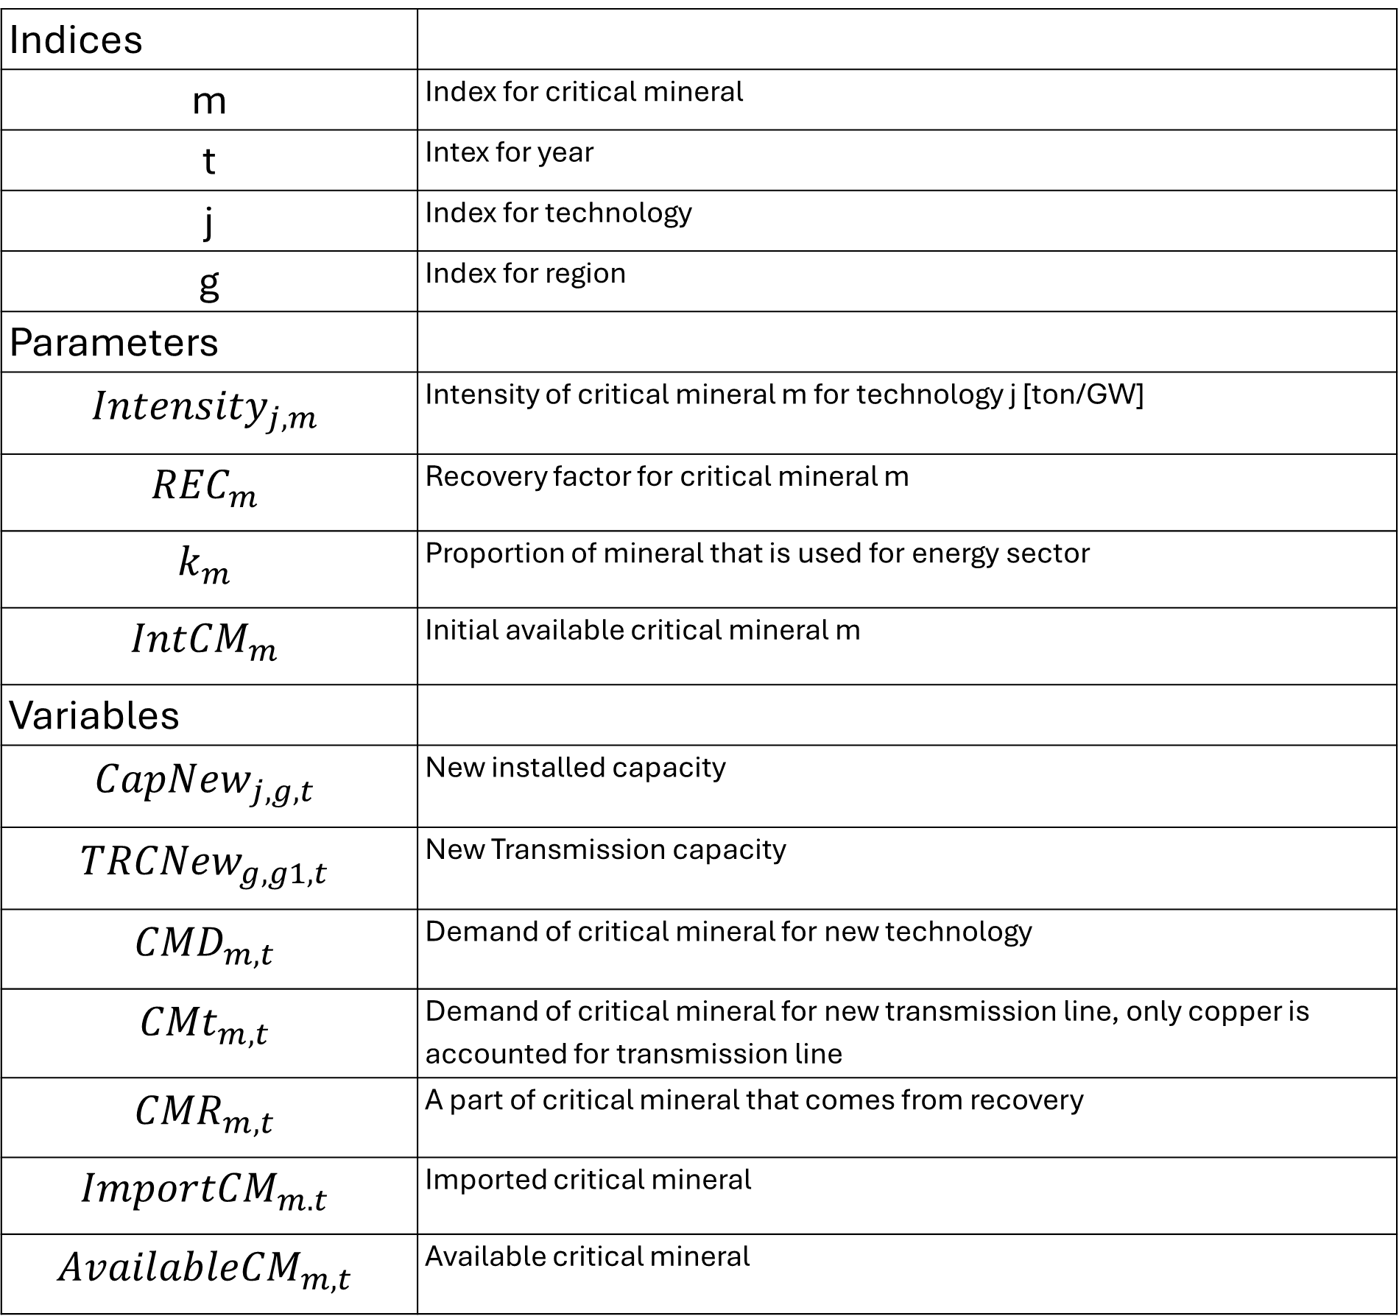
Summary of formulation
Indices
m | Index for critical mineral
t | Intex for year
j | Index for technology
g | Index for region
Parameters
$${Intensity}_{j,m}$$ | Intensity of critical mineral m for technology j [ton/GW]
$${REC}_{m}$$ | Recovery factor for critical mineral m
$$k_{m}$$ | Proportion of mineral that is used for energy sector
$${IntCM}_{m}$$ | Initial available critical mineral m
Variables
$${CapNew}_{j,g,t}$$ | New installed capacity
$${TRCNew}_{g,g1,t}$$ | New Transmission capacity
$${CMD}_{m,t}$$ | Demand of critical mineral for new technology
$${CMt}_{m,t}$$ | Demand of critical mineral for new transmission line, only copper is accounted for transmission line
$${CMR}_{m,t}$$ | A part of critical mineral that comes from recovery
$${ImportCM}_{m.t}$$ | Imported critical mineral
$${AvailableCM}_{m,t}$$ | Available critical mineral
$${CMD}_{m,t}=\sum_{j, g, t }{\left({CapNew}_{j,g,t}×{Intensity}_{j,m}\right)}$$
$${CMt}_{m,t}=\sum_{j, g, t }{\left({TRCNew}_{g,g1,t}×{Intensity}_{j,m}\right) if m in ′CU}′$$
$${CMR}_{m,t}=\sum_{j, g, t }{\left({DCAP}_{j,g,t}×{REC}_{m}×{Intensity}_{j,m}\right)}$$
$${AvailableCM}_{m,t}={AvailableCM}_{m,t−1}+k_{m}×{IntCM}_{m}+{ImportCM}_{m.t}−{{CMD}_{m,t}−{CMt}_{m,t}+CMR}_{m,t}$$

Slide 4
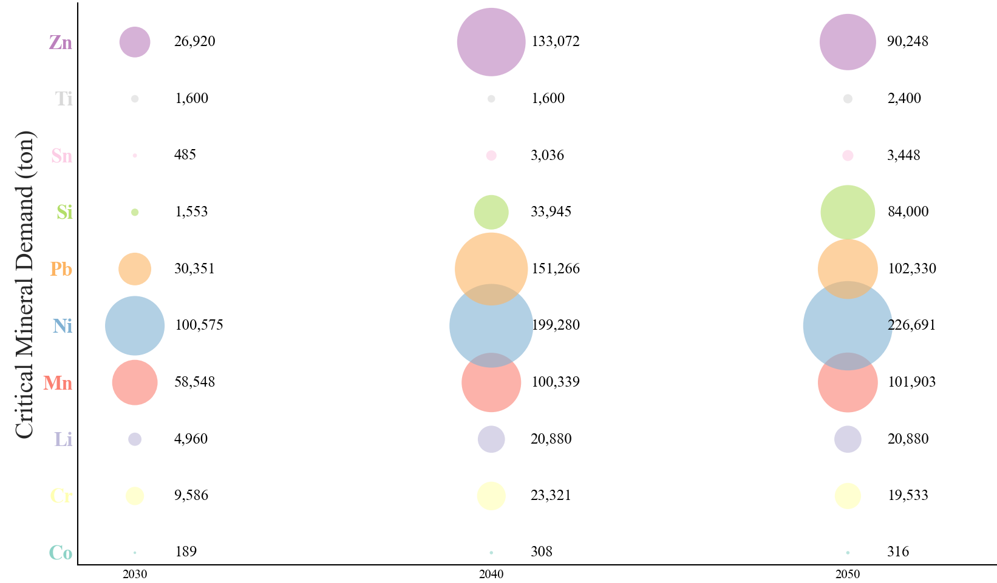

Slide 5
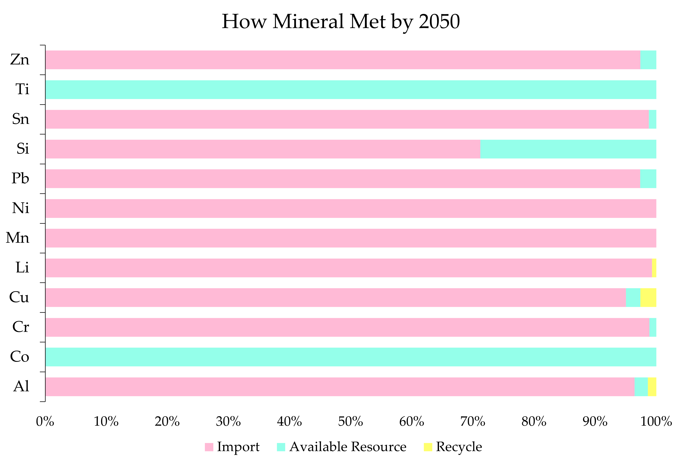

Slide 6
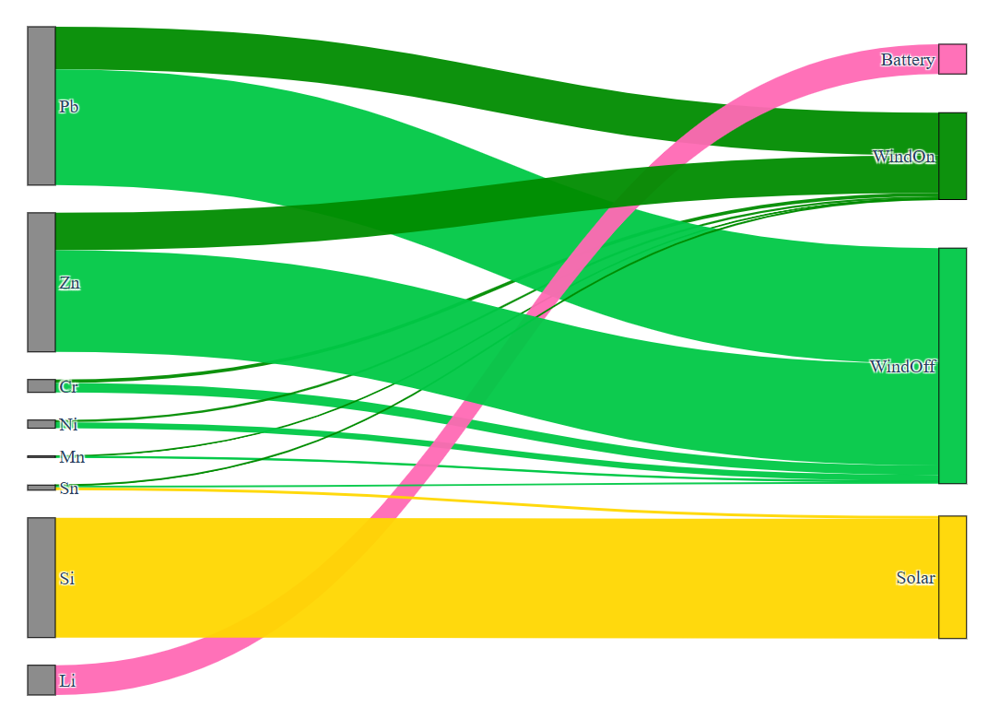
111130 ton
97561 ton
9021 ton
5754 ton
1058 ton
3590 ton
84000 ton
20880 ton

Slide 7
Multi-objective Results

Slide 8
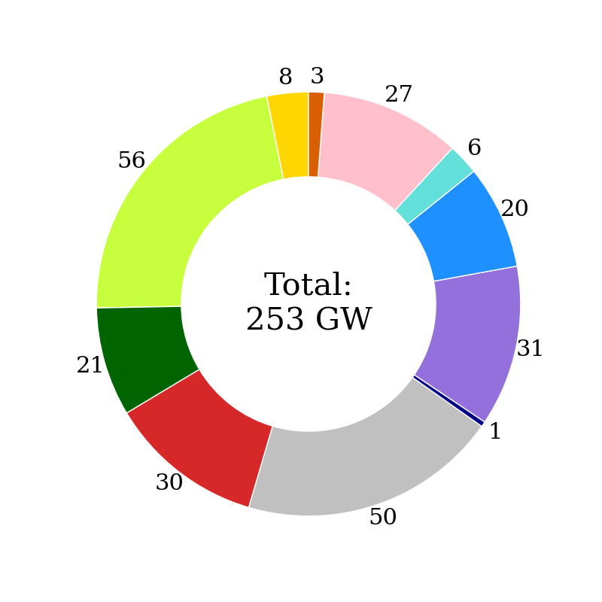
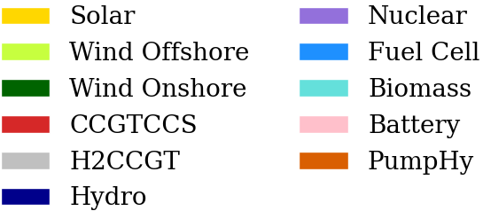
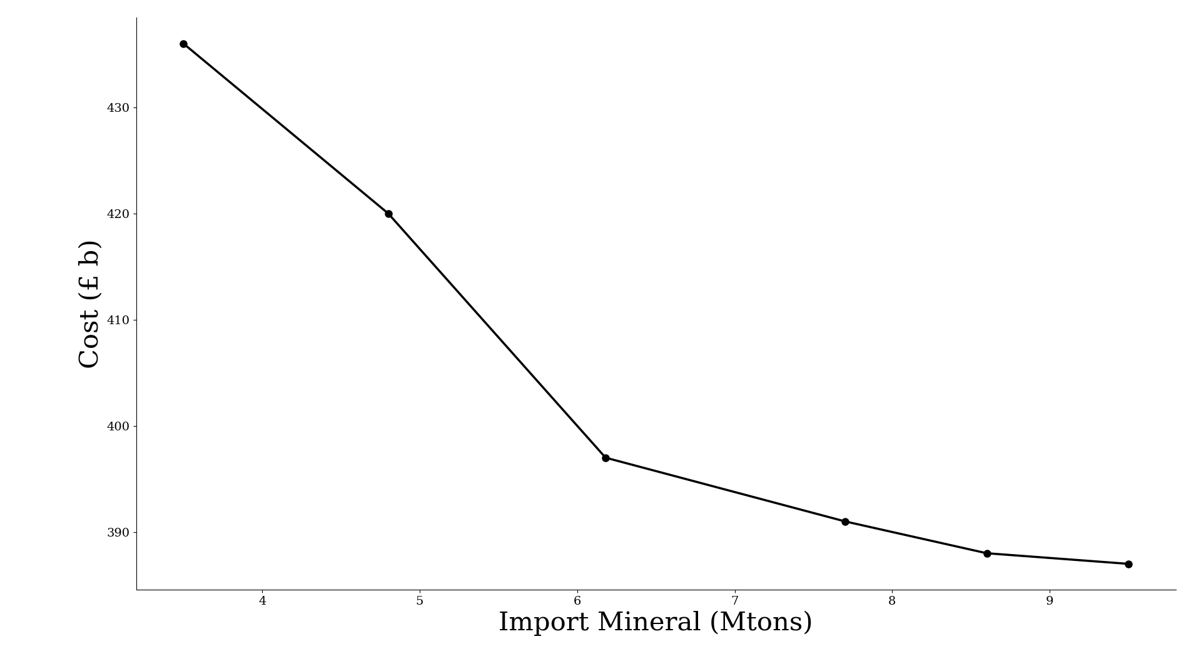
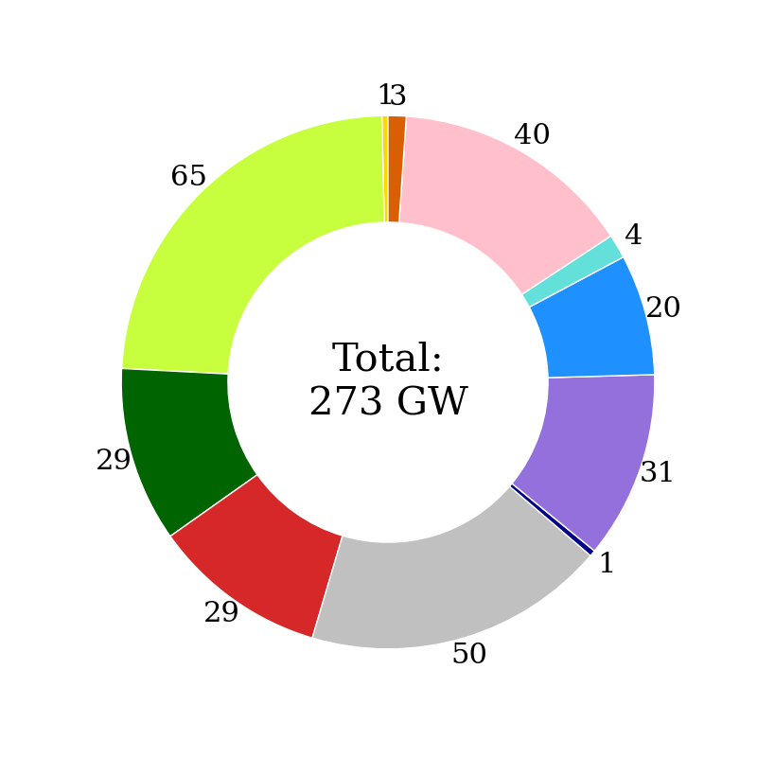
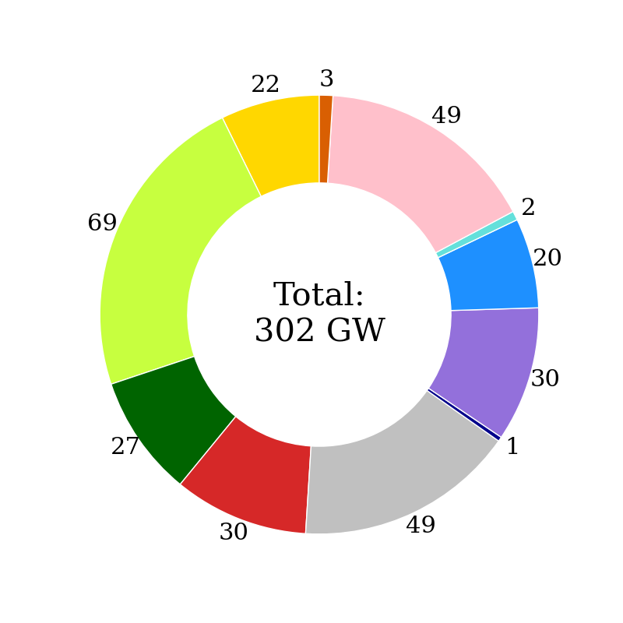
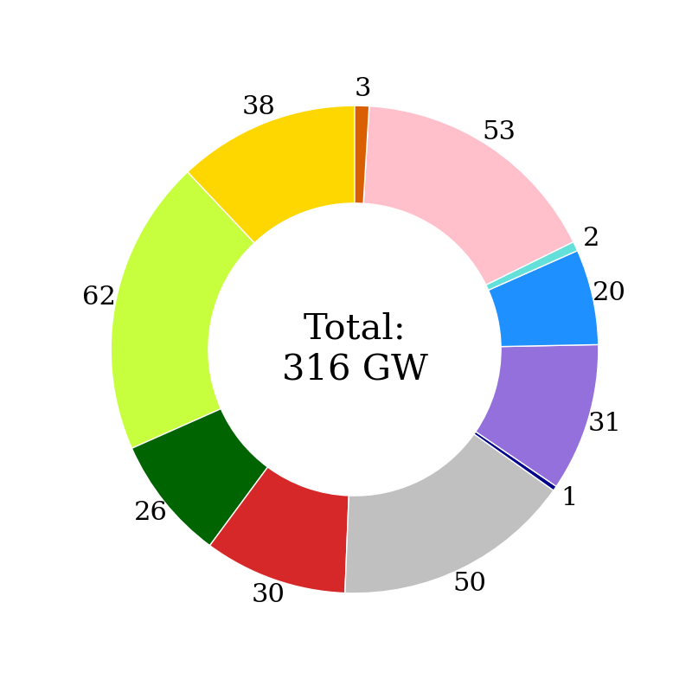
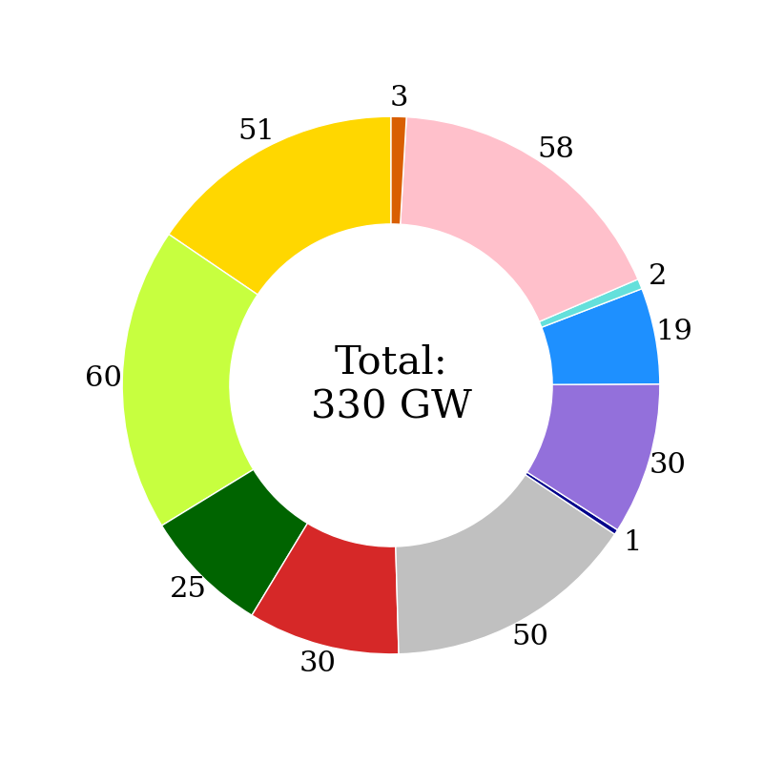
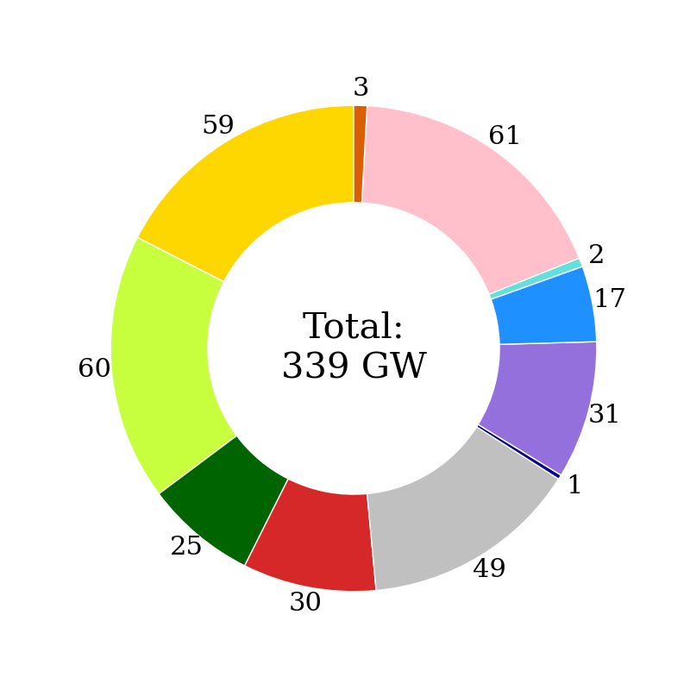

Slide 9
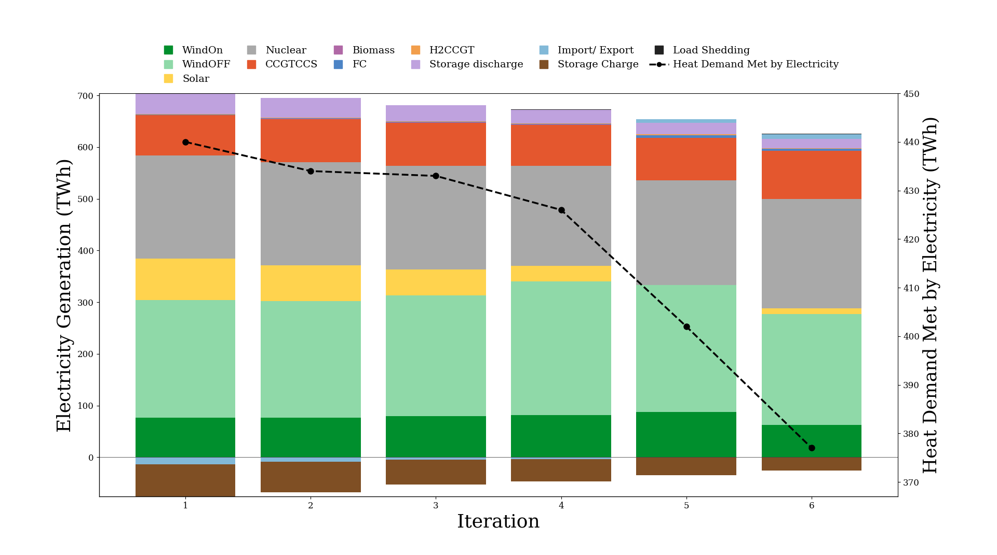

Slide 10
